Slide 1
K-SVD Dictionary-Learning for Analysis Sparse Models
*
Michael Elad
The Computer Science Department
The Technion – Israel Institute of technology
Haifa 32000, Israel
Joint work with
Ron Rubinstein
SPARS11 Workshop:
Signal Processing with Adaptive Sparse Structured Representations
June 27-30, 2011 - Edinburgh, (Scotland, UK)
and
Remi Gribonval, Mark Plumbley, Mike Davies, Sangnam Nam, Boaz Ophir, Nancy Bertin

Slide 2
Part I - Background Recalling the Synthesis Model and the K-SVD

Slide 3
The Synthesis Model – Basics
m
The synthesis representation is expected to be sparse:
Adopting a Bayesian point of view:
Draw the support at random
Choose the non-zero coefficients randomly (e.g. iid Gaussians)
Multiply by D to get the synthesis signal
Such synthesis signals belong to a Union-of-Subspaces (UoS):
This union contains subspaces, each of dimension k.
=
d
Dictionary

Slide 4
The Synthesis Model – Pursuit
Fundamental problem: Given the noisy measurements,
recover the clean signal x – This is a denoising task.
This can be posed as:
While this is a (NP-) hard problem, its approximated solution can be obtained by
Use L₁ instead of L₀ (Basis-Pursuit)
Greedy methods (MP, OMP, LS-OMP)
Hybrid methods (IHT, SP, CoSaMP)
Theoretical studies provide various guarantees for the success of these techniques, typically depending on k and properties of D.
Pursuit Algorithms

Slide 5
The Synthesis Model – Dictionary Learning
X
=
D
A
Field & Olshausen (96’)
Engan et. al. (99’)
…
Gribonval et. al. (04’)
Aharon et. al. (04’)
…
Each example is a linear combination of atoms from D
Each example has a sparse representation with no more than k atoms

Slide 6
The Synthesis Model – K-SVD
Aharon, E., & Bruckstein (`04)
Initialize D e.g. choose a subset of the examples
D
Recall: the dictionary update stage in the K-SVD is done one atom at a time, updating it using ONLY those examples who use it, while fixing the non-zero supports.
Sparse Coding
Use OMP or BP
Y
Dictionary Update
Column-by-Column by SVD computation

Slide 7
Part II - Analysis The Basics of the Analysis Model
S. Nam, M.E. Davies, M. Elad, and R. Gribonval, "Co-sparse Analysis Modeling - Uniqueness and Algorithms" , ICASSP, May, 2011.
S. Nam, M.E. Davies, M. Elad, and R. Gribonval, "The Co-sparse Analysis Model and Algorithms" , Submitted to ACHA, June 2011.

Slide 8
The Analysis Model – Basics
d
The analysis representation z is expected to be sparse
Co-sparsity: - the number of zeros in z.
Co-Support: Λ - the rows that are orthogonal to x
If Ω is in general position , then and thus we cannot expect to get a truly sparse analysis representation – Is this a problem? No!
Notice that in this model we put an emphasis on the zeros in the analysis representation, z, rather then the non-zeros. In particular, the values of the non-zeroes in z are not important to characterize the signal.
=
p
*
Analysis Dictionary

Slide 9
The Analysis Model – Bayesian View
d
Analysis signals, just like synthesis ones, can be generated in a systematic way:
Bottom line: an analysis signal x satisfies:
=
 | Synthesis Signals | Analysis Signals
Support: | Choose the support T (|T|=k) at random | Choose the co-support Λ (|Λ|= ) at random
Coef. : | Choose α_{T} at random | Choose a random vector v
Generate: | Synthesize by: D_{T}α_{T}=x | Orhto v w.r.t. Ω_{Λ}:
p
Analysis Dictionary

Slide 10
The Analysis Model – UoS
d
Analysis signals, just like synthesis ones, belong to a union of subspaces:
Example: p=m=2d:
Synthesis: k=1 (one atom) – there are 2d subspaces of dimensionality 1
Analysis: =d-1 leads to >>O(2^{d}) subspaces of dimensionality 1
=
 | Synthesis Signals | Analysis Signals
What is the Subspace Dimension: | k | d-
How Many Subspaces:
Who are those Subspaces:
p
Analysis Dictionary

Slide 11
The Analysis Model – Pursuit
Fundamental problem: Given the noisy measurements,
recover the clean signal x – This is a denoising task.
This goal can be posed as:
This is a (NP-) hard problem, just as in the synthesis case (and even harder!!!)
We can approximate its solution by
L₁ replacing L₀ (BP-analysis)
Greedy methods (OMP, …), and
Hybrid methods (IHT, SP, CoSaMP, …).
Theoretical studies should provide guarantees for the success of these techniques, typically depending on the co-sparsity and properties of Ω.

Slide 12
The Analysis Model – Backward Greedy
BG finds one row at a time from Λ for approximating the solution of
Variations and Improvements:
Gram-Schmidt applied to the accumulated rows speeds-up the algorithm.
An exhaustive alternative, xBG, can be used, where per each candidate row we test the decay in the projection energy and choose the smallest of them as the next row.
One could think of a forward alternative that detects the non-zero rows (GAP) – talk with Sangnam.
Initialization
No
Yes
Stop

Slide 13
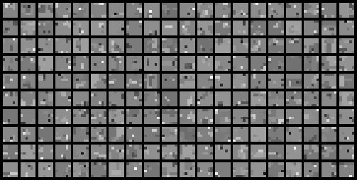
The Analysis Model – Low-Spark Ω
What if spark(Ω^{T})<<d ?
For example: a TV-like operator for image-patches of size 6×6 pixels (Ω size is 72×36)
Here are analysis-signals generated for co-sparsity ( ) of 32:
Their true co-sparsity is higher – see graph:
In such a case we may consider
More info: S. Nam, M.E. Davies, M. Elad, and R. Gribonval
800
700
600
500
# of signals
400
300
200
100
0
0
10
20
30
40
50
60
70
80
Co-Sparsity

Slide 14
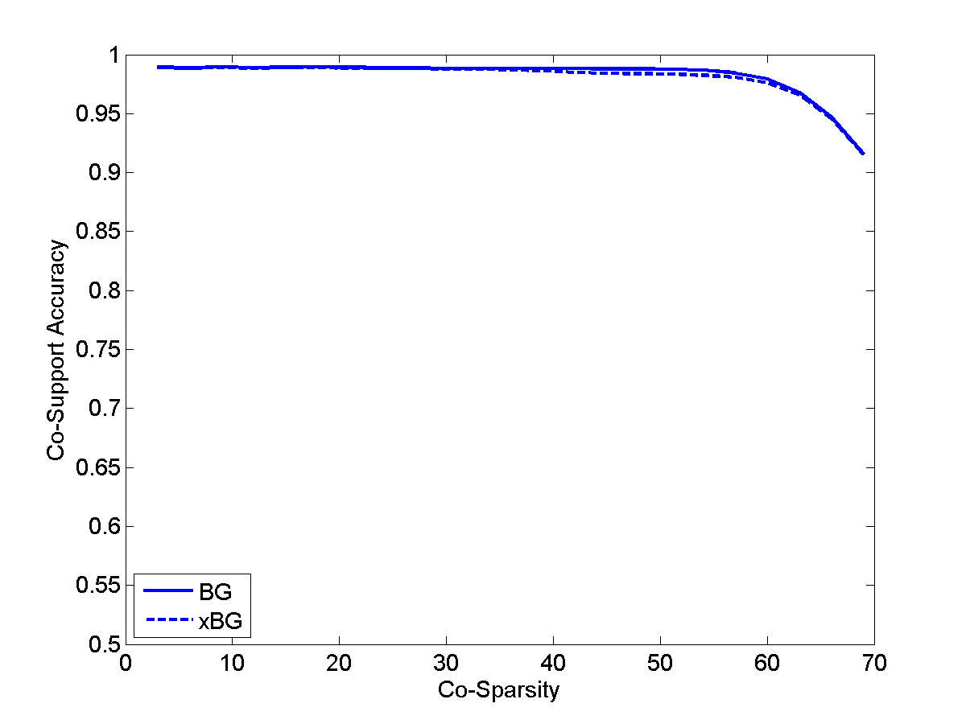
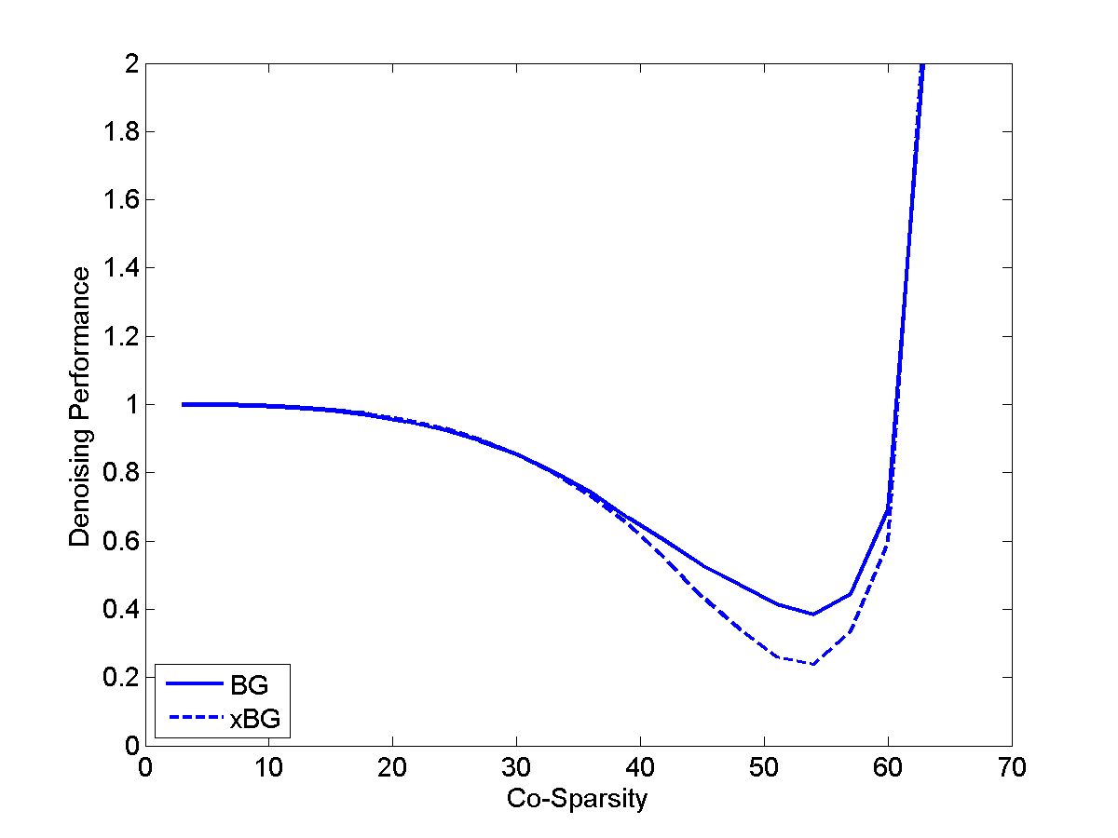
The Analysis Model – Low-Spark Ω – Pursuit
An example – performance of BG (and xBG) for these TV-like signals:
1000 signal examples, SNR=25
Accuracy of the co-support recovered
Denoising performance
BG or xBG

Slide 15
The Analysis Model – Summary
The analysis and the synthesis models are similar, and yet very different
The two align for p=m=d : non-redundant
Just as the synthesis, we should work on:
Pursuit algorithms (of all kinds) – Design
Pursuit algorithms (of all kinds) – Theoretical study
Dictionary learning from example-signals
Applications …
Our experience on the analysis model:
Theoretical study is harder
Different applications should be considered
m
=
d
d
=
p

Slide 16
Part III – Dictionaries Analysis Dictionary-Learning by K-SVD-Like Algorithm
B. Ophir, M. Elad, N. Bertin and M.D. Plumbley, "Sequential Minimal Eigenvalues - An Approach to Analysis Dictionary Learning", EUSIPCO, August 2011.
R. Rubinstein and M. Elad, "The Co-sparse Analysis Model and Algorithms" , will be submitted (very) soon to IEEE-TSP ....

Slide 17
Analysis Dictionary Learning – The Signals
X
=
A
We are given a set of N contaminated (noisy) analysis signals, and our goal is to recover their analysis dictionary, Ω

Slide 18
Analysis Dictionary Learning – Goal
Synthesis
Analysis
We shall adopt a similar approach to the K-SVD for approximating the minimization of the analysis goal

Slide 19
Analysis Dictionary – Sparse-Coding
Assuming that Ω is fixed, we aim at updating X
These are N separate analysis-pursuit problems. We suggest to use the BG or the xBG algorithms.

Slide 20
Analysis Dictionary – Dic. Update (1)
Assuming that X has been updated (and thus Λ_{j} are known), we now aim at updating a row (e.g. w_{k}^{T}) from Ω
We use only the signals S_{k} that are found orthogonal to w_{k}
Each example should keep its co-support Λ_{j}\k
Avoid trivial solution
Each of the chosen examples should be orthogonal to the new row w_{k}

Slide 21
Analysis Dictionary – Dic. Update (2)
This problem we have defined is too hard to handle
Intuitively, and in the spirit of the K-SVD, we could suggest the following alternative

Slide 22
Analysis Dictionary – Dic. Update (3)
This lacks in one of the forces on w_{k} that the original problem had
A better approximation for our original problem is
The obtained problem is a simple Rank-1 approximation problem, easily given by SVD

Slide 23
Analysis Dictionary Learning – Results (1)
Synthetic experiment #1: TV-Like Ω
We generate 30,000 TV-like signals of the same kind described before (Ω: 72×36, =32)
We apply 300 iterations of the Analysis K-SVD with BG (fixed ), and then 5 more using the xBG
Initialization by orthogonal vectors to randomly chosen sets of 35 examples
Additive noise: SNR=25. atom detected if:
100
Even though we have not identified Ω completely (~92% this time), we got an alternative feasible analysis dictionary with the same number of zeros per example, and a residual error within the noise level.
80
60
Relative Recovered Rows [%]
40
20
0
0
100
200
300
Iteration

Slide 24
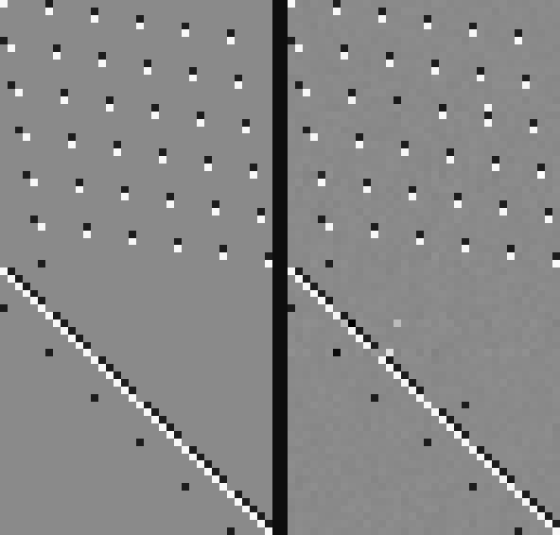
Analysis Dictionary Learning – Results (1)
Synthetic experiment #1: TV-Like Ω
Original Analysis Dictionary
Learned Analysis Dictionary

Slide 25
Analysis Dictionary Learning – Results (2)
Synthetic experiment #2: Random Ω
Very similar to the above, but with a random (full-spark) analysis dictionary Ω: 72×36
Experiment setup and parameters: the very same as above
In both algorithms: replacing BG by xBG (in both experiments) leads to a consistent descent in the relative error, and better recovery results. However, the run-time is ~50 times longer
100
As in the previous example, even though we have not identified Ω completely (~80% this time), we got an alternative feasible analysis dictionary with the same number of zeros per example, and a residual error within the noise level.
80
60
Relative Recovered Rows [%]
40
20
0
0
100
200
300
Iteration

Slide 26
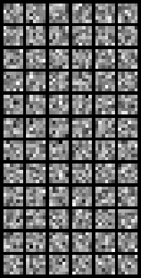
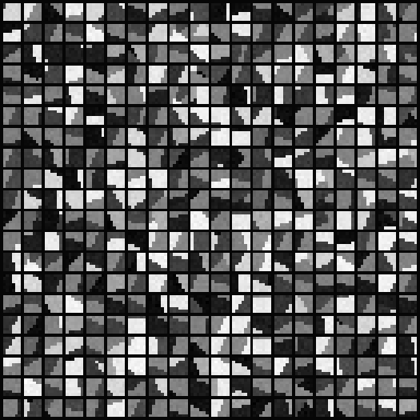
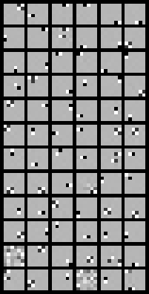
Analysis Dictionary Learning – Results (3)
Experiment #3: Piece-Wise Constant Image
We take 10,000 patches (+noise σ=5) to train on
Here is what we got:
Initial Ω
Trained (100 iterations) Ω
Original Image
Patches used for training

Slide 27
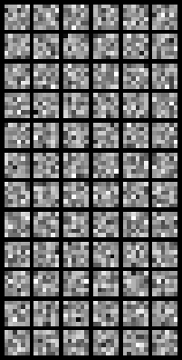
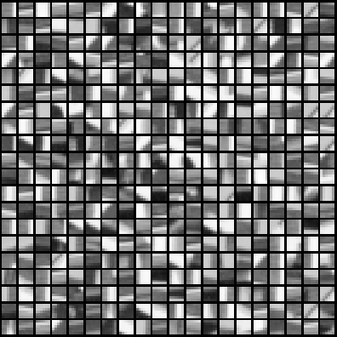
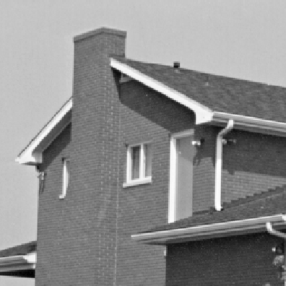
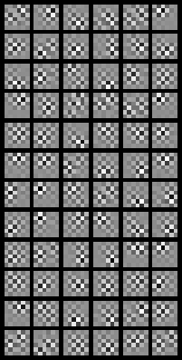
Analysis Dictionary Learning – Results (4)
Experiment #3: The Image “House”
We take 10,000 patches (+noise σ=10) to train on
Here is what we got:
Initial Ω
Trained (100 iterations) Ω
Original Image
Patches used for training

Slide 28
Part IV – We Are Done Summary and Conclusions

Slide 29
Today We Have Seen that …
Sparsity and Redundancy are practiced mostly in the context of the synthesis model
Yes, the analysis model is a very appealing (and different) alternative, worth looking at
Is there any other way?
We propose new algorithms (e.g. K-SVD like) for this task. The next step is applications that will benefit from this
In the past few years there is a growing interest in better defining this model, suggesting pursuit methods, analyzing them, etc.
So, what to do?
What about Dictionary learning?
More on these (including the slides and the relevant papers) can be found in http://www.cs.technion.ac.il/~elad

