Slide 1
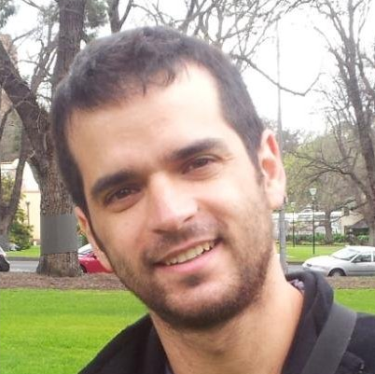
SOS Boosting of Image Denoising Algorithms
*
Michael Elad
The Computer Science Department
The Technion – Israel Institute of technology
Haifa 32000, Israel
January
2015
Switzerland
* Joint work with Yaniv Romano
The research leading to these results has received funding from the European Research Council under European Union's Seventh Framework Program, ERC Grant agreement no. 320649, and by the Intel Collaborative Research Institute for Computational Intelligence

Slide 2
Leading Image Denoising Methods
Are built upon powerful patch-based (local) image models:
Non-Local Means (NLM): self-similarity within natural images
K-SVD: sparse representation modeling of image patches
BM3D: combines a sparsity prior and non local self-similarity
Kernel-regression: offers a local directional filter
EPLL: exploits a GMM model of the image patches
…
Today we present a way to improve various such state-of-the-art image denoising methods, simply by applying the original algorithm as a “black-box” several times
SOS Boosting of Image Denoising Algorithms
By Michael Elad

Slide 3
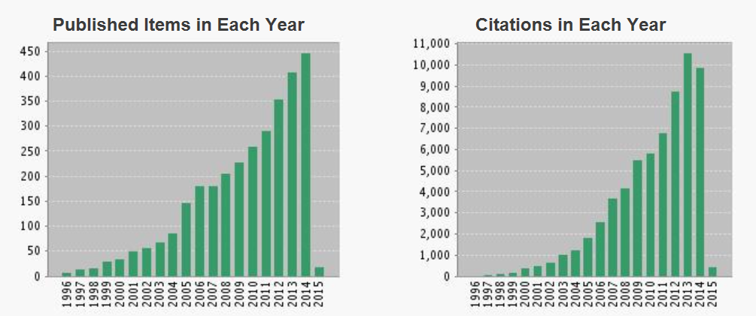
Leading Image Denoising Methods
Are built upon powerful patch-based (local) image models:
Non-Local Means (NLM): self-similarity within natural images
K-SVD: sparse representation modeling of image patches
BM3D: combines a sparsity prior and non local self-similarity
Kernel-regression: offers a local directional filter
EPLL: exploits a GMM model of the image patches
…
Search: “Image and Denoising” in ISI Web-of-Science
Today we present a way to improve various such state-of-the-art image denoising methods, simply by applying the original algorithm as a “black-box” several times
SOS Boosting of Image Denoising Algorithms
By Michael Elad

Slide 4
Background

Slide 5
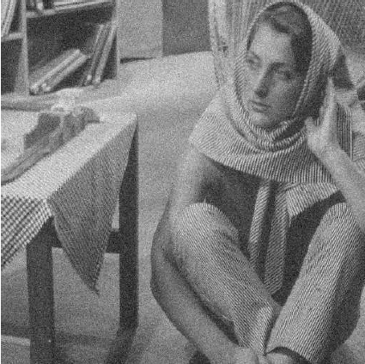
Boosting Methods for Denoising
Improved results can be achieved by processing the residual/method-noise image:
Noisy image
$$y$$
Denoised image
$$\hat{x}=f\left(y\right)$$
Method Noise
$$y−\hat{x}$$
SOS Boosting of Image Denoising Algorithms
By Michael Elad

Slide 6
Processing the Residual Image
Twicing [Tukey (’77), Charest et al. (’06)]
${\hat{x}}^{k+1}={\hat{x}}^{k}+f\left(y−{\hat{x}}^{k}\right)$
Method noise whitening [Romano & Elad (‘13)]
Recovering the “stolen” content from the method-noise using the same basis elements that were chosen to represent the initially denoised patches
TV denoising using Bregman distance [Bregman (‘67), Osher et al. (’05)]
${\hat{x}}^{k+1}=f\left({\hat{x}}^{k}+\sum_{i=1}^{k}{\left(y−{\hat{x}}^{i}\right)}\right)$
SOS Boosting of Image Denoising Algorithms
By Michael Elad

Slide 7
Boosting Methods
Diffusion [Perona-Malik (’90), Coifman et al. (’06), Milanfar (’12)]
Removes the noise leftovers that are found in the denoised image
${\hat{x}}^{k+1}=f\left({\hat{x}}^{k}\right)$
SAIF [Talebi et al. (’12)]
Chooses automatically the local improvement mechanism:
Diffusion
Twicing
SOS Boosting of Image Denoising Algorithms
By Michael Elad

Slide 8
Reducing the Local/Global Gap
EPLL [Zoran & Weiss (’09), Sulam & Elad (‘14)]
Treats a major shortcoming of patch-based methods:
The gap between the local patch processing and the global need for a whole restored image
By encouraging the patches of the final image (i.e. after patch aggregation) to comply with the local prior
In practice – iterated denoising with a diminishing variance
Denoising the patches of ${\hat{x}}^{k}$
Obtain ${\hat{x}}^{k+1}$by averaging the overlapping patches
SOS Boosting of Image Denoising Algorithms
By Michael Elad

Slide 9
SOS Boosting

Slide 10
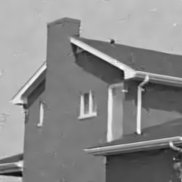
Strengthen - Operate - Subtract Boosting
Given any denoiser, how can we improve its performance?
Denoise
SOS Boosting of Image Denoising Algorithms
By Michael Elad

Slide 11
Strengthen - Operate - Subtract Boosting
Given any denoiser, how can we improve its performance?
Denoise
Previous Result
Strengthen the signal
Operate the denoiser
SOS Boosting of Image Denoising Algorithms
By Michael Elad

Slide 12
Strengthen - Operate - Subtract Boosting
Given any denoiser, how can we improve its performance?
Denoise
Previous Result
Strengthen the signal
Operate the denoiser
Subtract the previous estimation from the outcome
SOS formulation: ${\hat{x}}^{k+1}=f\left(y+{\hat{x}}^{k}\right)−{\hat{x}}^{k}$
SOS Boosting of Image Denoising Algorithms
By Michael Elad

Slide 13
Strengthen - Operate - Subtract Boosting
An improvement is obtained since $SNR\left\{y+\hat{x}\right\}>SNR\left\{y\right\}$
In the ideal case, where $\hat{x}=x$, we get
We suggest strengthening the underlying signal, rather than
Adding the residual back to the noisy image
Twicing converges to the noisy image
Filtering the previous estimate over and over again
Diffusion could lead to over-smoothing, converging to a piece-wise constant image
$$SNR\left\{y+x\right\}=2⋅SNR\left\{y\right\}$$
SOS Boosting of Image Denoising Algorithms
By Michael Elad

Slide 14
Image Denoising – A Matrix Formulation
In order to study the convergence of the SOS function, we represent the denoiser in its matrix form
The properties of $W$:
Kernel-based methods (e.g. Bilateral filter, NLM, Kernel Regression) can be approximated as row-stochastic positive definite matrices [Milanfar (’13)]
Has eigenvalues in the range [0,…,1]
What about sparsity-based methods?
$$\hat{x}=f\left(y\right)=W y$$
SOS Boosting of Image Denoising Algorithms
By Michael Elad

Slide 15
Sparsity Model – The Basics
We assume the existence of a dictionary $D∈ℝ^{d×n}$ whose columns are the atom signals
Signals are modeled as sparse linear
combinations of the dictionary atoms:
where $\underline{α}$ is sparse, meaning that it is assumed to contain mostly zeros
The computation of $\underline{α}$ from $\underline{x}$ (or its or its noisy version) is called sparse-coding
The OMP is a popular sparse-coding technique, especially for low dimensional signals
D
…
$$\underline{x}=D\underline{α}$$
$$\underline{x}$$
=
D
$$\underline{α}$$
SOS Boosting of Image Denoising Algorithms
By Michael Elad

Slide 16
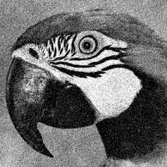
K-SVD Image Denoising [Elad & Aharon (‘06)]
Noisy Image
Initial Dictionary
Using KSVD
Update the Dictionary
Denoise each patch
Using OMP
$${\hat{p}}_{i} = D_{S_{i}}α_{i}$$
$$= D_{S_{i}}{\left(D_{S_{i}}^{T}D_{S_{i}}\right)}^{−1}D_{S_{i}}^{T}R_{i}y$$
Denoised Patch
A linear combination of few atoms
$$α_{i}=\min_{z}{{\left\|D_{S_{i}}z−R_{i}y\right\|}_{2}^{2}}$$
$R_{i}$ extracts the $i^{th}$ patch from $y$
SOS Boosting of Image Denoising Algorithms
By Michael Elad

Slide 17
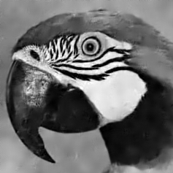
K-SVD Image Denoising [Elad & Aharon (‘06)]
Noisy Image
Initial Dictionary
Using KSVD
Reconstructed Image
Update the Dictionary
Denoise each patch
Using OMP
$\hat{x}=\min_{x}{μ{\left\|x−y\right\|}_{2}^{2}+\sum_{i}{{\left\|{\hat{p}}_{i}−R_{i}x\right\|}_{2}^{2}}}$
$={\left(μI+\sum_{i}{R_{i}^{T}R_{i}}\right)}^{−1}\left(μI+\sum_{i}{R_{i}^{T}}D_{S_{i}}{\left(D_{S_{i}}^{T}D_{S_{i}}\right)}^{−1}D_{S_{i}}^{T}R_{i}\right)y$
$=Wy$
SOS Boosting of Image Denoising Algorithms
By Michael Elad

Slide 18
K-SVD: A Matrix Formulation
$W$ is a sum of projection matrices, and has the following properties:
Symmetric, $W^{T}=W$ (by assuming periodic boundary condition)
Positive definite, $W≻0$
Minimal eigenvalue $λ_{min}\left(W\right)≥c$, where $c=\frac{μ}{μ+n}>0$
$μ$ is the global averaging constant, and $n$ is the patch size
$W\underline{1}=\underline{1}$, thus $λ$=1 is eigenvalue corresponding to the eigenvector $\underline{1}$
The spectral radius ${\left\|W\right\|}_{2}=1$, thus $λ_{max}\left(W\right)=1$
$W$ may have negative entries, which violates the classic definition of row-stochasticness
The spectral radius ${\left\|W−I\right\|}_{2}≤ 1−c<1$
SOS Boosting of Image Denoising Algorithms
By Michael Elad

Slide 19
Convergence Study
SOS formulation: ${\hat{x}}^{k}=W_{k}\left(y+{\hat{x}}^{k−1}\right)−{\hat{x}}^{k−1}$
Given:
${\hat{x}}^{∗}$– the denoised image that obtained for a large $k$
$W_{k}$ , $k=1,2,…$ – A series of filter-matrices
The error $e_{k}={\hat{x}}^{k}−{\hat{x}}^{∗}$ of the recursive function is expressed by
By assuming $W_{k}=W_{∗}$ from a certain $k$ (which comes up in practice):
$$e_{k}=\left(W_{k}−I\right)e_{k−1}+\left(W_{k}−W_{∗}\right)\left(y+{\hat{x}}^{∗}\right)$$
$$e_{k}=\left(W−I\right)e_{k−1}$$
SOS Boosting of Image Denoising Algorithms
By Michael Elad

Slide 20
Convergence Study
The SOS recursive function converges if ${\left\|W−I\right\|}_{2}<1$
Holds both for kernel-based (Bilateral filter, NLM, Kernel Regression), and sparsity-based methods (K-SVD).
For most denoising algorithms the SOS boosting is “guaranteed” to converge to
$${\hat{x}}^{∗}={\left(2I−W\right)}^{−1}y$$
SOS formulation: ${\hat{x}}^{k}=W_{k}\left(y+{\hat{x}}^{k−1}\right)−{\hat{x}}^{k−1}$
SOS Boosting of Image Denoising Algorithms
By Michael Elad

Slide 21
Generalization
We introduce 2 parameters that modify
The steady-state outcome
The requirements for convergence (the eigenvalues range)
The rate of convergence
The parameter $ρ$, expressed by
Controls the signal emphasis
Affects the steady-state outcome
$${\hat{x}}^{k+1}=f\left(y+{ρ\hat{x}}^{k} \right)−{ρ\hat{x}}^{k}$$
SOS Boosting of Image Denoising Algorithms
By Michael Elad

Slide 22
Generalization
The second parameter, $τ$, controls the rate-of-convergence
The steady state outcome is given by
Multiplying both sides by $τ$, and adding $\left({\hat{x}}^{∗}−{\hat{x}}^{∗}\right)$ to the RHS (does not effect the steady state result)
Rearranging the equation above, and replacing ${\hat{x}}^{∗}$ with ${\hat{x}}^{k}$ leading to the generalized SOS recursive function:
$${\hat{x}}^{∗}=f\left(y+{ρ\hat{x}}^{∗} \right)−{ρ\hat{x}}^{∗}$$
$$τ{\hat{x}}^{∗}=τf\left(y+{ρ\hat{x}}^{∗} \right)−{τρ\hat{x}}^{∗}+{\hat{x}}^{∗}−{\hat{x}}^{∗}$$
$${\hat{x}}^{k+1}=τf\left(y+{ρ\hat{x}}^{k} \right)−{\left(τρ+τ−1\right)\hat{x}}^{k}$$
SOS Boosting of Image Denoising Algorithms
By Michael Elad

Slide 23
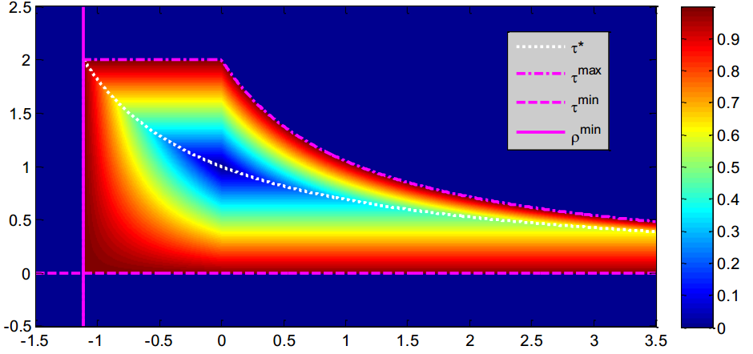
Generalization
By assuming $W_{k}=W_{∗}$, the error $e_{k}={\hat{x}}^{k}−{\hat{x}}^{∗}$is given by
As a result, $ρ$and $τ$control the rate-of-convergence
We suggest a closed-form expression for the optimal ($ρ,τ$) setting
Given $ρ$, what is the best $τ$, leading to the fastest convergence?
$$e_{k}=\left(τρW_{k}−\left(τρ+τ−1\right)I\right)e_{k−1}$$
Largest eigenvalue of the error’s transition matrix
$$τ$$
$$ρ$$
SOS Boosting of Image Denoising Algorithms
By Michael Elad

Slide 24
Experiments

Slide 25
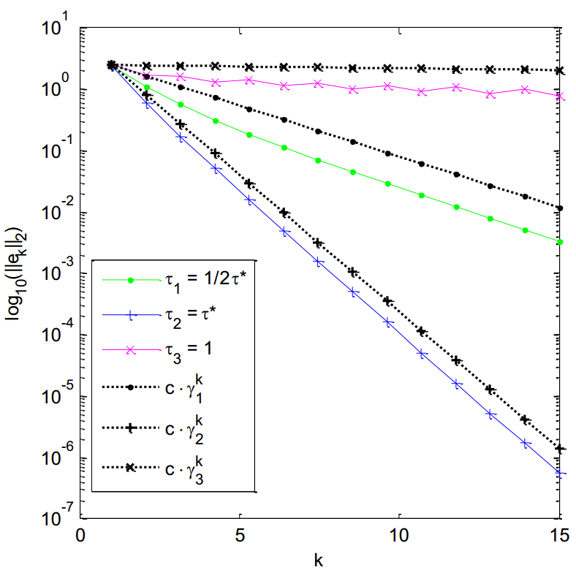
Verifying the Convergence Study
We apply the K-SVD on the noisy House image $\left(σ=25\right)$, with a fixed $W$
$τ^{∗}$ is the outcome of our closed-form expression, achieving the fastest convergence
$γ$ is our analytic expression that bounds the error (largest eigenvalue of the error’s transition matrix)
$$\log_{10}\left\|e_{k}\right\|$$
Iteration number
SOS Boosting of Image Denoising Algorithms
By Michael Elad

Slide 26
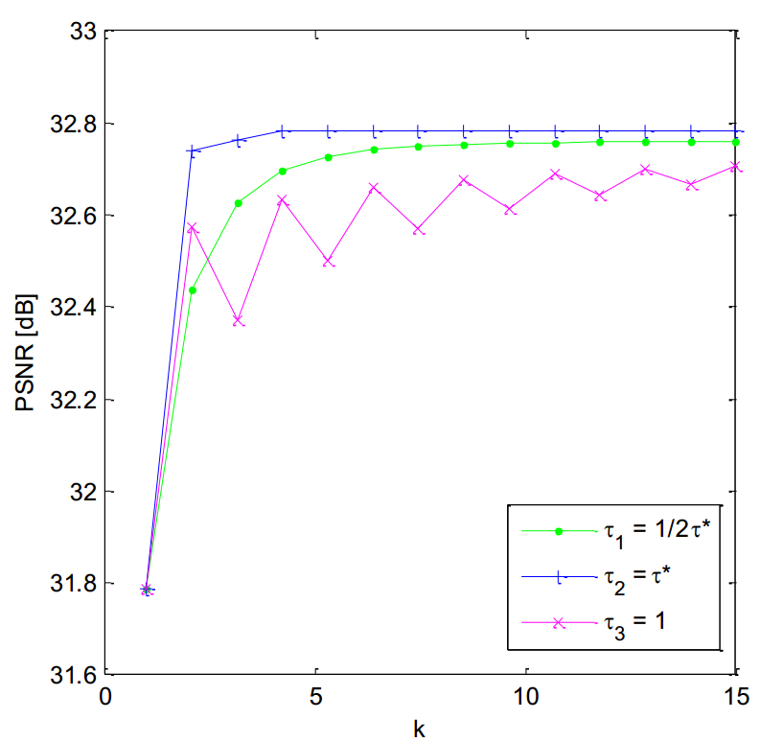
Convergence
We apply the K-SVD on noisy House image $σ=25$, with a fixed $W$
Converges faster and improves the PSNR
PSNR of ${\hat{x}}^{k}$ [dB]
$$\log_{10}\left\|e_{k}\right\|$$
Iteration number
Iteration number
SOS Boosting of Image Denoising Algorithms
By Michael Elad

Slide 27
Results
We successfully boost several state-of-the-art denoising algorithms:
K-SVD, NLM, BM3D, and EPLL
Without any modifications, simply by applying the original software as a “black-box”
We manually tuned two parameters
$ρ$– signal emphasis factor
$σ$ – noise level, which is an input to the denoiser
Since the noise level of $y+{ρx}^{k}$ is higher than the one of $y$
SOS Boosting of Image Denoising Algorithms
By Michael Elad

Slide 28
Quantitative Comparison
Average PSNR* over 5 images (higher is better):
K-SVD
$$σ$$ | Avg. PSNR original | Avg. PSNR with SOS | Avg. Boosting
10 | 35.12 | 35.25 | 0.13
20 | 32.04 | 32.26 | 0.22
25 | 31.02 | 31.28 | 0.26
50 | 27.20 | 27.97 | 0.77
75 | 24.57 | 25.83 | 1.26
100 | 23.11 | 23.92 | 0.81
*$PSNR=20\log_{10}\left({255}/{\sqrt{MSE}}\right)$

Slide 29
Quantitative Comparison
Average PSNR* over 5 images (higher is better):
NLM
$$σ$$ | Avg. PSNR original | Avg. PSNR with SOS | Avg. Boosting
10 | 33.97 | 34.41 | 0.44
20 | 31.10 | 31.44 | 0.34
25 | 29.93 | 30.34 | 0.41
50 | 26.43 | 26.73 | 0.30
75 | 24.11 | 24.67 | 0.56
100 | 22.67 | 23.03 | 0.36
*$PSNR=20\log_{10}\left({255}/{\sqrt{MSE}}\right)$

Slide 30
Quantitative Comparison
Average PSNR* over 5 images (higher is better):
BM3D
$$σ$$ | Avg. PSNR original | Avg. PSNR with SOS | Avg. Boosting
10 | 35.40 | 35.41 | 0.01
20 | 32.56 | 32.58 | 0.02
25 | 31.58 | 31.61 | 0.03
50 | 28.51 | 28.58 | 0.07
75 | 26.58 | 26.69 | 0.11
100 | 24.99 | 25.13 | 0.14
*$PSNR=20\log_{10}\left({255}/{\sqrt{MSE}}\right)$

Slide 31
Quantitative Comparison
Average PSNR* over 5 images (higher is better):
EPLL
$$σ$$ | Avg. PSNR original | Avg. PSNR with SOS | Avg. Boosting
10 | 35.02 | 35.15 | 0.13
20 | 32.01 | 32.26 | 0.25
25 | 30.97 | 31.23 | 0.26
50 | 27.74 | 28.04 | 0.30
75 | 25.74 | 26.06 | 0.32
100 | 24.20 | 24.47 | 0.27
*$PSNR=20\log_{10}\left({255}/{\sqrt{MSE}}\right)$

Slide 32
Quantitative Comparison
Average boosting in PSNR* over 5 images (higher is better):
Noise std | Improved Methods
$$σ$$ | K-SVD | NLM | BM3D | EPLL
10 | 0.13 | 0.44 | 0.01 | 0.13
20 | 0.22 | 0.34 | 0.02 | 0.25
25 | 0.26 | 0.41 | 0.03 | 0.26
50 | 0.77 | 0.30 | 0.07 | 0.30
75 | 1.26 | 0.56 | 0.11 | 0.32
100 | 0.81 | 0.36 | 0.14 | 0.27
*$PSNR=20\log_{10}\left({255}/{\sqrt{MSE}}\right)$
SOS Boosting of Image Denoising Algorithms
By Michael Elad

Slide 33
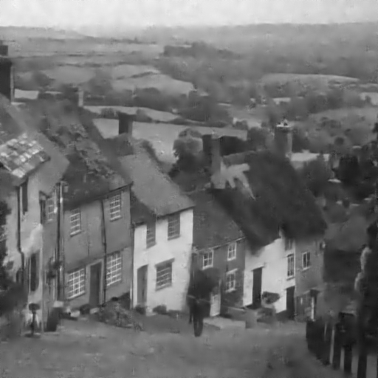
Visual Comparison: K-SVD
Original K-SVD results, $σ=25$
29.06dB
SOS Boosting of Image Denoising Algorithms
By Michael Elad

Slide 34
Visual Comparison: K-SVD
SOS K-SVD results, $σ=25$
29.41dB
SOS Boosting of Image Denoising Algorithms
By Michael Elad

Slide 35
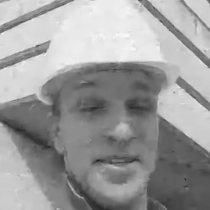
Visual Comparison: EPLL
Original EPLL results, $σ=25$
Forman
House
32.44dB
32.07dB
SOS Boosting of Image Denoising Algorithms
By Michael Elad

Slide 36
Visual Comparison: EPLL
SOS EPLL results, $σ=25$
Forman
House
32.78dB
32.38dB
SOS Boosting of Image Denoising Algorithms
By Michael Elad

Slide 37
Reducing the
“Local-Global” Gap

Slide 38
Reaching a Consensus
It turns out that the SOS boosting treats a major shortcoming of many patch-based methods:
Local processing of patches VS. the global need in a whole denoised result
We define the local disagreements by
Disagreement
patch
Local independent denoised patch
Globally averaged patch
The disagreements
Naturally exist since each noisy patch is denoised independently
Are based on the intermediate results
SOS Boosting of Image Denoising Algorithms
By Michael Elad

Slide 39
“Sharing the Disagreement”
Inspired by the “Consensus and Sharing” problem from game-theory:
There are several agents, each one of them aims to minimize its individual cost (i.e., representing the noisy patch sparsely)
These agents affect a shared objective term, describing the overall goal (i.e., obtaining the globally denoised image)
Imitating this concept, we suggest sharing the disagreements
Noisy patches
Patch-based denoising
Patch Avg.
Est. Image
Disagreement per-patch
Noisy image
SOS Boosting of Image Denoising Algorithms
By Michael Elad

Slide 40
Connection to SOS Boosting
Interestingly, for a fixed filter matrix $W$, “sharing the disagreement” and the SOS boosting are equivalent
The connection to the SOS is far from trivial because
The SOS is blind to the intermediate results (the independent denoised patches, before patch-averaging)
The intermediate results are crucial for “sharing the disagreement” approach
$${\hat{x}}^{k+1}=W\left(y+{\hat{x}}^{k} \right)−{\hat{x}}^{k}$$
The SOS boosting reduces the Local/Global gap
SOS Boosting of Image Denoising Algorithms
By Michael Elad

Slide 41
Conclusions
The SOS boosting algorithm:
Easy to use
In practice, we treat the denoiser $f\left(⋅\right)$ as a “black-box”
Applicable to a wide range of denoising algorithms
Guaranteed to converge for most denoising algorithms
Thus, has a straightforward stopping criterion
Reduces the local-global gap
Improves the state-of-the-art methods
SOS Boosting of Image Denoising Algorithms
By Michael Elad

Slide 42
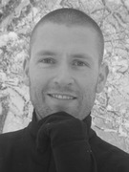
Thank You For Your Attention & Thanks To the Organizer of BASP Frontiers Yves Wiaux
SOS Boosting of Image Denoising Algorithms
By Michael Elad

