Slide 1

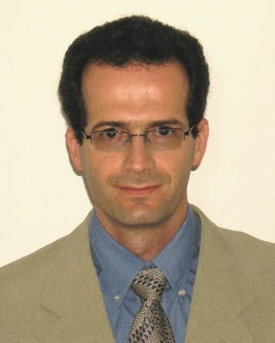

Generalized Tree-Based Wavelet Transform and Applications to Patch-Based Image Processing
*
Michael Elad
The Computer Science Department
The Technion – Israel Institute of technology
Haifa 32000, Israel
*Joint work with
Idan Ram Israel Cohen
The Electrical Engineering department the Technion – Israel Institute of Technology
A Seminar in the Hebrew University of Jerusalem

Slide 2
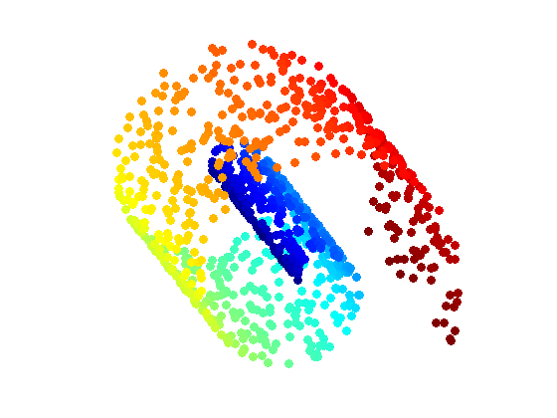
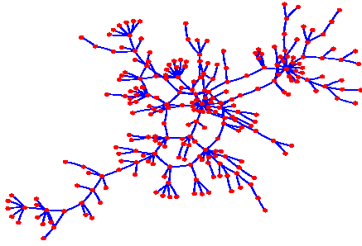
This Talk is About …
Processing of Non-Conventionally Structured Signals
Many signal-processing tools (filters, transforms, …) are tailored for uniformly sampled signals
Now we encounter different types of signals: e.g., point-clouds and graphs. Can we extend classical tools to these signals?
Our goal: Generalize the wavelet transform to handle this broad family of signals
In the process, we will find ourselves returning to “regular” signals, handling them differently
2

Slide 3

Previous and Related Work
“Diffusion Wavelets”
R. R. Coifman, and M. Maggioni, 2006.
“Multiscale Methods for Data on Graphs and Irregular Multidimensional Situations”
M. Jansen, G. P. Nason, and B. W. Silverman, 2008.
“Wavelets on Graph via Spectal Graph Theory”
D. K. Hammond, and P. Vandergheynst, and R. Gribonval, 2010.
“Multiscale Wavelets on Trees, Graphs and High Dimensional Data: Theory and Applications to Semi Supervised Learning”
M . Gavish, and B. Nadler, and R. R. Coifman, 2010.
“Wavelet Shrinkage on Paths for Denoising of Scattered Data”
D. Heinen and G. Plonka, to appear
3

Slide 4
Part I – GTBWT Generalized Tree-Based Wavelet Transform – The Basics
I. Ram, M. Elad, and I. Cohen, “Generalized Tree-Based Wavelet Transform”, IEEE Trans. Signal Processing, vol. 59, no. 9, pp. 4199–4209, 2011.
I. Ram, M. Elad, and I. Cohen, “Redundant Wavelets on Graphs and High Dimensional Data Clouds”, IEEE Signal Processing Letters, Vol. 19, No. 5, pp. 291–294 , May 2012.
4

Slide 5



Problem Formulation
We start with a set of points $X=\left\{x_{1},x_{2},…,x_{N}\right\}∈{\text{IR}}^{d}$. These could be
  Feature points associated with the nodes of a graph.
  Set of coordinates for a point-cloud in high-dimensional space.
A scalar function is defined on these coordinates, $f:\text{X}→$ $\text{IR}$ , our signal to process is $f=\left[f_{1},f_{2}, …,f_{N}\right]$.
We may regard this dataset as a set of samples taken from a high-dimensional function $f\left(x\right):{\text{IR}}^{d}→\text{IR}$ .
Key assumption – A distance-measure $w\left(x_{i},x_{j}\right)$ between points in ${\text{IR}}^{d}$ is available to us. The function behind the scene is “regular”:
$$X=\left\{x_{1},x_{2},…,x_{N}\right\}$$
…
…
$$f=\left[f_{1},f_{2}, …,f_{N}\right]$$
Small $w\left(x_{i},x_{j}\right)$implies small $\left|f\left(x_{i}\right)−f\left(x_{j}\right)\right|$ for almost every pair $\left(i,j\right)$
5

Slide 6


Our Goal
$$X=\left\{x_{1},x_{2},…,x_{N}\right\}$$
Sparse
(compact) Representation
Wavelet Transform
$$f$$
$$\left[f_{1},f_{2}, …,f_{N}\right]$$
We develop both an orthogonal wavelet transform and a redundant alternative, both efficiently representing the input signal f.
Our problem: The regular wavelet transform produces a small number of large coefficients when it is applied to piecewise regular signals. But, the signal (vector) f is not necessarily smooth in general.
6

Slide 7























The Main Idea (1) - Permutation
$$f_{1}$$
$$f_{2}$$
$$f_{3}$$
$$f_{4}$$
$$f_{5}$$
$$f_{6}$$
$$f_{7}$$
$$f_{8}$$
$$f$$
Permutation using $X=\left\{x_{1},x_{2},…,x_{N}\right\}$
$$f_{2}$$
$$f_{7}$$
$$f_{4}$$
$$f_{1}$$
$$f_{3}$$
$$f_{5}$$
$$f_{6}$$
$$f_{8}$$
$$f_{p}$$
Permutation
1D Wavelet
$$f_{p}$$
$${\tilde{\text{f}}}_{p}$$
$$f$$
P
T
Processing
T⁻¹
P⁻¹
$$\tilde{f }$$
7

Slide 8















The Main Idea (2) - Permutation
In fact, we propose to perform a different permutation in each resolution level of the multi-scale pyramid:
Naturally, these permutations will be applied reversely in the inverse transform.
Thus, the difference between this and the plain 1D wavelet transform applied on f are the additional permutations, thus preserving the transform’s linearity and unitarity, while also adapting to the input signal.
$$a_{l}$$
$${\text{P}}_{l}$$
$$\overline{h}$$
$$↓2$$
$$a_{l+1}$$
$${\text{P}}_{l+1}$$
$$\overline{h}$$
$$↓2$$
$$a_{l+2}$$
$$\overline{g}$$
$$↓2$$
$$d_{l+1}$$
$$\overline{g}$$
$$↓2$$
$$d_{l+2}$$
8

Slide 9
Building the Permutations (1)
Lets start with P₀ – the permutation applied on the incoming signal.
Recall: the wavelet transform is most effective for piecewise regular signals. → thus, P₀ should be chosen such that P₀f is most “regular”.
So, … for example, we can simply permute by sorting the signal f …
250
250
200
200
150
150
100
100
50
50
0
0
50
100
150
200
250
0
0
50
100
150
200
250
9

Slide 10

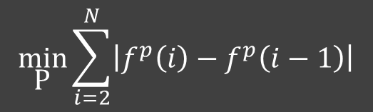
Building the Permutations (2)
However: we will be dealing with corrupted signals f (noisy, missing values, …) and thus such a sort operation is impossible.
To our help comes the feature vectors in X, which reflect on the order of the signal values, f_{k}. Recall:
Thus, instead of solving for the optimal permutation that “simplifies” f, we order the features in X to the shortest path that visits in each point once, in what will be an instance of the Traveling-Salesman-Problem (TSP):
Small $w\left(x_{i},x_{j}\right)$implies small $\left|f\left(x_{i}\right)−f\left(x_{j}\right)\right|$ for almost every pair $\left(i,j\right)$
$$\min_{\text{P}}{\sum_{i=2}^{N}{\left|f^{p}\left(i\right)−f^{p}\left(i−1\right)\right|}}$$
$$\min_{\text{P}}{\sum_{i=2}^{N}{w\left(x_{i}^{p},x_{i−1}^{p}\right)}}$$
10

Slide 11



























Building the Permutations (3)
$${\text{IR}}^{d}$$
$$f_{1}$$
$$f_{2}$$
$$f_{3}$$
$$f_{4}$$
$$f_{5}$$
$$f_{6}$$
$$f_{7}$$
$$f_{8}$$
$$x_{2}$$
$$x_{7}$$
$$f$$
$$x_{8}$$
$$x_{4}$$
$$x_{5}$$
$$x_{1}$$
$$x_{6}$$
$$x_{3}$$
$$f_{2}$$
$$f_{7}$$
$$f_{4}$$
$$f_{1}$$
$$f_{3}$$
$$f_{5}$$
$$f_{6}$$
$$f_{8}$$
$$f_{p}$$
We handle the TSP task by a simple (and crude) approximation:
Initialize with an arbitrary index j;
Initialize the set of chosen indices to Ω(1)={j};
Repeat k=1:1:N-1 times:
  Find x_{i} – the nearest neighbor to x_{Ω(k)} such that i∉Ω;
  Set Ω(k+1)={i};
Result: the set Ω holds the proposed ordering.
11

Slide 12




Building the Permutations (4)
So far we concentrated on P₀ at the finest level of the multi-scale pyramid.
In order to construct P₁, P₂, … , P_{L-1}, the permutations at the other pyramid’s levels, we use the same method, applied on propagated (reordered, filtered and sub-sampled) feature-vectors through the same wavelet pyramid:
$$X^{1}$$
$$X^{0}=X$$
P₀
LP-Filtering (h) & Sub-sampling
P₁
LP-Filtering (h) & Sub-sampling
$$X^{3}$$
$$X^{2}$$
LP-Filtering (h) & Sub-sampling
P₃
LP-Filtering (h) & Sub-sampling
P₂
12

Slide 13
Why “Generalized Tree …”?
“Generalized” tree Tree (Haar wavelet)
Our proposed transform: Generalized Tree-Based Wavelet Transform (GTBWT).
We also developed a redundant version of this transform based on the stationary wavelet transform [Shensa, 1992] [Beylkin, 1992] – also related to the “A-Trous Wavelet” (will not be presented here).
At this stage we could (or should) show how this works on point clouds/graphs, but we will take a different route and demonstrate these tools for images.
13

Slide 14
Part II – Handling Images Using GTBWT for Image Denoising and Beyond
14

Slide 15





Could Images Fit This Data-Structure?
Yes. Starting with an image of size $\sqrt{N}×\sqrt{N},$do the following:
  Extract all possible patches of size $\sqrt{d}×\sqrt{d}$ with complete overlaps – these will serve as the set of features (or coordinates) matrix X.
  The values $f\left(x_{i}\right)=f_{i}$ will be the center pixel in these patches.
Once constructed this way, we forget all about spatial proximities in the image , and start thinking in terms of (Euclidean) proximities between patches.
$$f\left(x_{j}\right)=f_{j}$$
$$x_{j}$$
*
* Not exactly. Actually, if we search the nearest-neighbors within a limited window, some of the spatial proximity remains.
$$x_{i}$$
$$f\left(x_{i}\right)=f_{i}$$
15

Slide 16
Lets Try (1)
For a 128×128 center portion of the image Lenna, we compare the image representation efficiency of the
GTBWT
A common 1D wavelet transform
2D wavelet transform.
We measure efficiency by the m-term approximation error, i.e. reconstructing the image from m largest coefficients, zeroing the rest.
GTBWT – permutation
at the finest level
55
50
45
40
PSNR
35
2D
30
25
20
common 1D
db4
15
10
0
2000
4000
6000
8000
10000
# Coefficients
16

Slide 17
Lets Try (2)
For a 128×128 center portion of the image Lenna, we compare the image representation efficiency of the
GTBWT
A common 1D wavelet transform
2D wavelet transform.
We measure efficiency by the m-term approximation error, i.e. reconstructing the image from m largest coefficients, zeroing the rest.
GTBWT – permutations
at the finest two level
55
50
45
40
PSNR
35
2D
30
25
20
common 1D
common 1D
db4
db4
15
10
0
2000
4000
6000
8000
10000
# Coefficients
17

Slide 18
Lets Try (3)
For a 128×128 center portion of the image Lenna, we compare the image representation efficiency of the
GTBWT
A common 1D wavelet transform
2D wavelet transform.
We measure efficiency by the m-term approximation error, i.e. reconstructing the image from m largest coefficients, zeroing the rest.
GTBWT – permutations
at the finest three level
55
50
45
40
PSNR
35
2D
30
25
20
common 1D
db4
15
10
0
2000
4000
6000
8000
10000
# Coefficients
18

Slide 19
Lets Try (4)
For a 128×128 center portion of the image Lenna, we compare the image representation efficiency of the
GTBWT
A common 1D wavelet transform
2D wavelet transform.
We measure efficiency by the m-term approximation error, i.e. reconstructing the image from m largest coefficients, zeroing the rest.
GTBWT – permutations
at all (10) levels
55
50
45
40
PSNR
35
2D
30
25
20
common 1D
db4
15
10
0
2000
4000
6000
8000
10000
# Coefficients
19

Slide 20
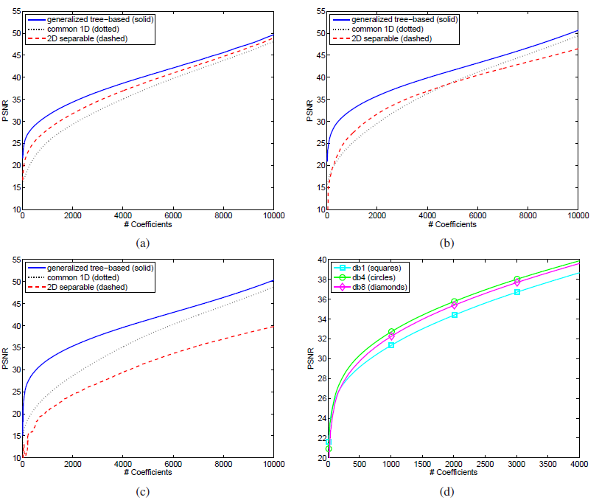
Comparison Between Different Wavelets
db1 (Haar)
db4
GTBWT
comparison
db8
20

Slide 21
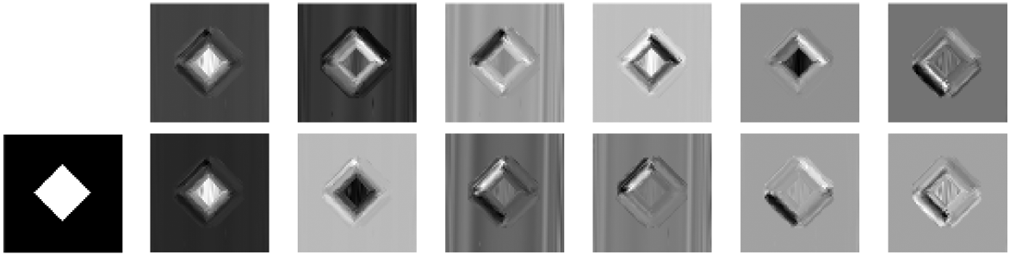
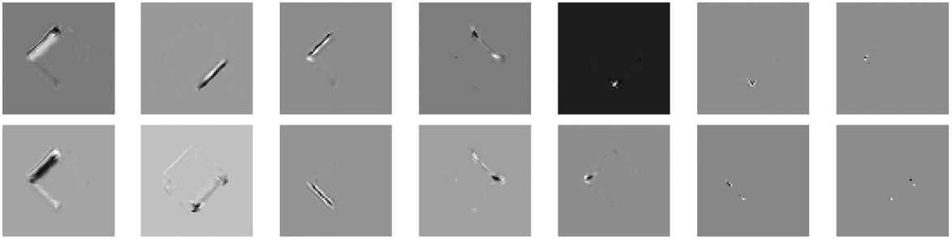












The Representation’s Atoms – Synthetic Image
wavelets
wavelets
wavelets
wavelets
wavelets
Scaling functions
$$l=12$$
$$l=11$$
$$l=10$$
$$l=9$$
$$l=8$$
Original
image
wavelets
wavelets
wavelets
wavelets
wavelets
wavelets
wavelets
$$l=7$$
$$l=6$$
$$l=5$$
$$l=4$$
$$l=3$$
$$l=2$$
$$l=1$$
21

Slide 22
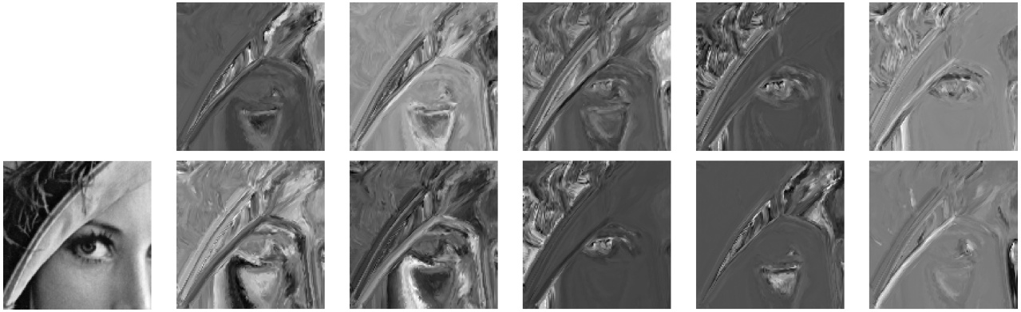
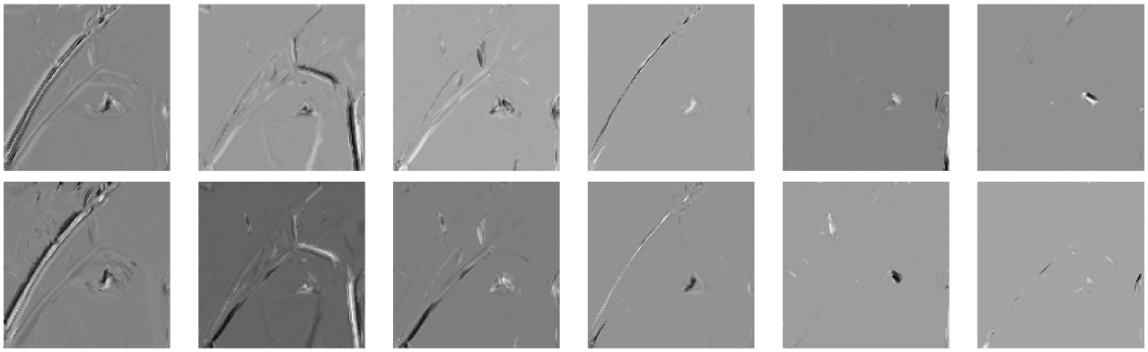










The Representation’s Atoms – Lenna
wavelets
wavelets
wavelets
wavelets
Scaling functions
$$l=10$$
$$l=9$$
$$l=8$$
$$l=7$$
Original
image
wavelets
wavelets
wavelets
wavelets
wavelets
wavelets
$$l=6$$
$$l=5$$
$$l=4$$
$$l=3$$
$$l=2$$
$$l=1$$
22

Slide 23





Image Denoising using GTBWT
We assume that the noisy image, $\tilde{F}$, is a noisy version of a clean image, $F$, contaminated by white zero-mean Gaussian additive noise with known STD=σ.
The vectors $\tilde{\text{f}}$ and $\text{f}$ are lexicographic ordering of the noisy and clean images.
Our goal: recover $\text{f}$ from $\tilde{\text{f}}$, and we will do this using shrinkage over GTBWT:
  We extract all patches from the noisy image as described above;
  We apply the GTBWT on this data set;
  The wavelet coefficients obtained go through a shrinkage operation; and
  We transform back to get the final outcome.
$$x_{j}$$
$$f\left(x_{j}\right)=f_{j}$$
$$x_{i}$$
$$f\left(x_{i}\right)=f_{i}$$
23

Slide 24


Image Denoising – Block-Diagram
Noisy image
$$\tilde{\text{f}}$$
GTBWT
Reconstructed image
Hard
thresholding
(GTBWT)⁻¹
$$\hat{\text{f}}$$
24

Slide 25
Image Denoising – Improvements
Cycle-spinning: Apply the above scheme several (10) times, with a different GTBWT (different random ordering), and average.
GTBWT
THR
GTBWT⁻¹
Noisy image
Reconstructed image
Averaging
GTBWT
THR
GTBWT⁻¹
25

Slide 26




Image Denoising – Improvements
Sub-image averaging: A by-product of GTBWT is the propagation of the whole patches. Thus, we get n transform vectors, each for a shifted version of the image and those can be averaged.
$$X^{1}$$
$$X^{0}=X$$
P₀
LP-Filtering (h) & Sub-sampling
P₁
LP-Filtering (h) & Sub-sampling
HP-Filtering (g) & Sub-sampling
HP-Filtering (g) & Sub-sampling
$$X^{3}$$
LP-Filtering (h) & Sub-sampling
P₃
LP-Filtering (h) & Sub-sampling
P₂
$$X^{2}$$
HP-Filtering (g) & Sub-sampling
HP-Filtering (g) & Sub-sampling
26

Slide 27
Image Denoising – Improvements
Sub-image averaging: A by-product of GTBWT is the propagation of the whole patches. Thus, we get n transform vectors, each for a shifted version of the image and those can be averaged.
Combine these transformed pieces;
The center row is the transformed coefficients of f.
The other rows are also transform coefficients – of n shifted versions of the image.
We can reconstruct n versions of the image and average.
$$X^{1}$$
$$X^{0}=X$$
P₀
LP-Filtering (h) & Sub-sampling
P₁
LP-Filtering (h) & Sub-sampling
HP-Filtering (g) & Sub-sampling
HP-Filtering (g) & Sub-sampling
$$X^{3}$$
LP-Filtering (h) & Sub-sampling
P₃
LP-Filtering (h) & Sub-sampling
P₂
$$X^{2}$$
HP-Filtering (g) & Sub-sampling
HP-Filtering (g) & Sub-sampling
27

Slide 28
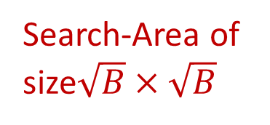
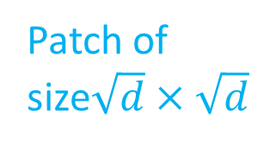
Image Denoising – Improvements
Restricting the NN: It appears that when searching the nearest-neighbor for the ordering, restriction to near-by area is helpful, both computationally (obviously) and in terms of the output quality.
Patch of size$\sqrt{d}×\sqrt{d}$
Search-Area of size$\sqrt{B}×\sqrt{B}$
28

Slide 29





Image Denoising – Improvements
Improved thresholding: Instead of thresholding the wavelet coefficients based on their value, threshold them based on the norm of the (transformed) vector they belong to:
Recall the transformed vectors as described earlier.
Classical thresholding: every coefficient within $\text{C}$ is passed through the function:
The proposed alternative would be to force “joint-sparsity” on the above array of coefficients, forcing all rows to share the same support:
$$c_{1,3}$$
$$\text{C}\text{=}$$
$$c_{i,j}=\left\{\begin{matrix}c_{i,j} & \left|c_{i,j}\right|≥T \\ 0 & \left|c_{i,j}\right|<T\end{matrix}\right.$$
$$c_{i,j}=\left\{\begin{matrix}c_{i,j} & {\left\|c_{∗,j}\right\|}_{2}≥T \\ 0 & {\left\|c_{∗,j}\right\|}_{2}<T\end{matrix}\right.$$
29

Slide 30
Image Denoising – Results
We apply the proposed scheme with the Symmlet 8 wavelet to noisy versions of the images Lena and Barbara
For comparison reasons, we also apply to the two images the K-SVD and BM3D algorithms.
The PSNR results are quite good and competitive.
What about run time?
σ/PSNR | Image | K-SVD | BM3D | GTBWT
10/28.14 | Lena | 35.51 | 35.93 | 35.87
 | Barbara | 34.44 | 34.98 | 34.94
25/20.18 | Lena | 31.36 | 32.08 | 32.16
 | Barbara | 29.57 | 30.72 | 30.75
30

Slide 31
Relation to BM3D?
BM3D
Our scheme
3D Transform & threshold
In a nut-shell, while BM3D searches for patch neighbors and process them locally, our approach seeks one path through all the patches (each gets its own neighbors as a consequence), and the eventual processing is done globally.
3D Transform & threshold
Reorder,
GTBWT, and threshold
31

Slide 32
Part III – Time to Finish Conclusions and a Bit More
32

Slide 33
Conclusions
We propose a new wavelet transform for scalar functions defined on graphs or high dimensional data clouds.
The proposed transform extends the classical orthonormal and redundant wavelet transforms.
We demonstrate the ability of these transforms to efficiently represent and denoise images.
What next? The following extremes will appear soon:
Complicate things: Use this transform as a regularizer in inverse problems – we have done that and getting excellent results; or
Simplify things: Keep only the zero-resolution level of the pyramid – see illustration in the next slides.
33

Slide 34
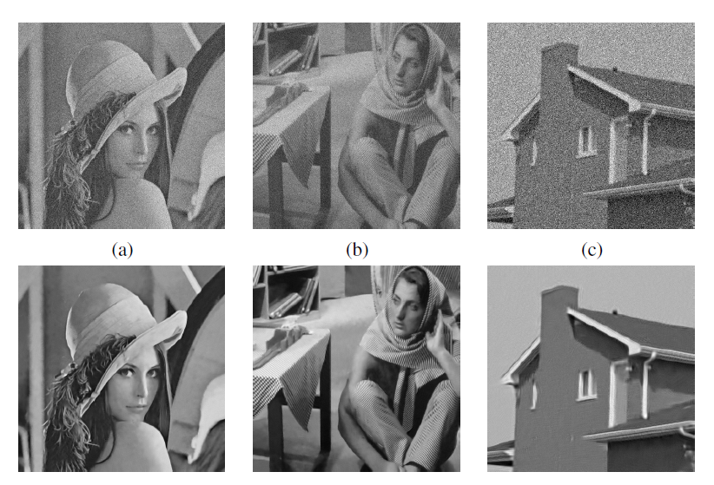
What if we Keep Only the Reordering?
Noisy with σ=25 (20.18dB)
Extract all (with overlaps) patches of size 9×9
Order these patches as before
Reconstruction: 32.39dB
*
Take the center-row – it represents a permutation of the image pixels to a regular function
Smooth/filter the values along this row in a simple way
* This result is obtained with (i) cycle-spinning, (ii) sub-image averaging, and (iii) two iterations.
34

Slide 35


Why Should This Work?
Noisy with σ=25 (20.18dB)
True samples
Noisy samples
$$f$$
Reconstruction: 32.39dB
Ordering based on the noisy pixels
Simple smoothing
$$f_{p}$$
35

Slide 36
The “Simple Smoothing” We Do
While simple smoothing works fine, one could do better by:
1. Training the smoothing filter to perform “optimally”:
  Take a clean image and create a noisy version of it.
  Apply the denoising algorithm as described, but when getting to the stage where a filter is to be used, optimize its taps so that the reconstruction MSE (w.r.t. to the clean image) is minimized.
2. Applying several filters and switching between them base don the local patch content.
3. Turning to non-linear edge-preserving filters (e.g. bilateral filter).
➔ The results above correspond to ideas 1 and 2
36

Slide 37
What About Inpainting?
0.8 of the pixels are missing
Order these patches as before distance uses EXISTING pixels only
Extract all (with overlaps) patches of size 9×9
Reconstruction: 27.15dB
*
Take the center-row – it represents a permutation of the image pixels to a regular function
Interpolate missing values along this row in a simple way
* This result is obtained with (i) cycle-spinning, (ii) sub-image averaging, and (iii) two iterations.
37

Slide 38

The Rationale
0.8 of the pixels are missing
Missing sample
Existing sample
$$f$$
Reconstruction: 27.15dB
Ordering
Simple interpolation
$$f_{p}$$
38

